Slide 1
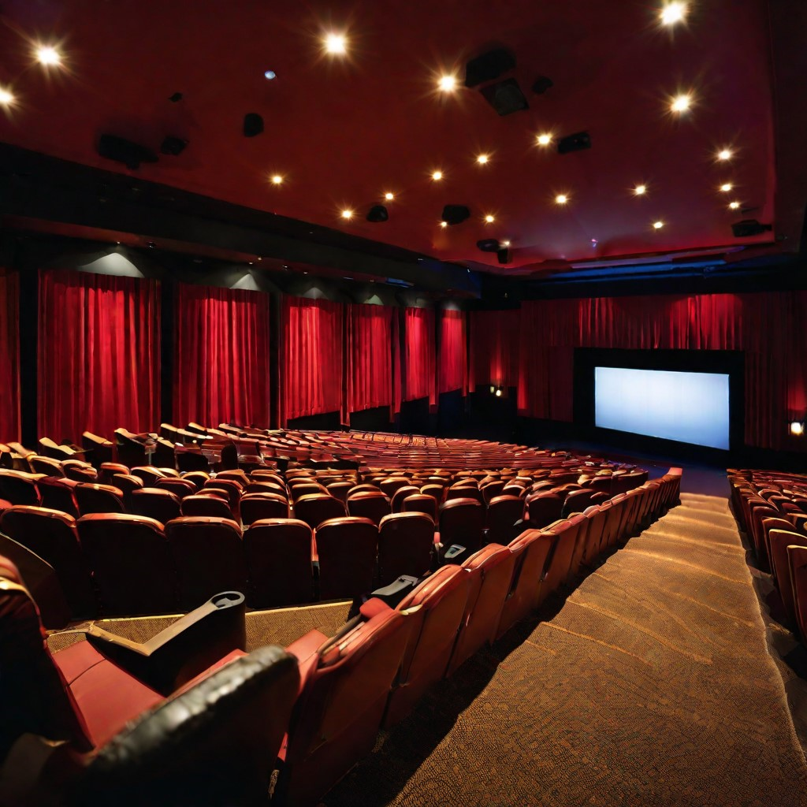
Movie Rating App: An AI-Powered Experience
Prerak Varshney E22CSEU0138
Navkar Jain E22CSEU0146
Ameya Vatsa E22CSEU0141

Slide 2

Introduction
Welcome to our presentation on the movie ratings app powered by AI modules like pandas, numpy, and TruncatedSVD. Our app is designed to provide users with personalized movie recommendations based on their preferences and viewing history. Additionally, our app offers a platform for users to rate and review movies, providing valuable data for data analytics and marketing strategies. In this presentation, we will explore the AI modules used in our app, the user interface, recommendation system, ratings and reviews, data analytics, marketing strategy, and future developments.

Slide 3

AI Modules Used in the App
Pandas:
Pandas is a powerful open-source data analysis and manipulation tool used for data cleaning, preparation, and analysis.
Numpy:
Numpy is a fundamental package for scientific computing with Python, used for numerical analysis and matrix operations.
TruncatedSVD:
TruncatedSVD is a dimensionality reduction technique used to reduce the number of dimensions in a dataset while preserving as much variance as possible.

Slide 4
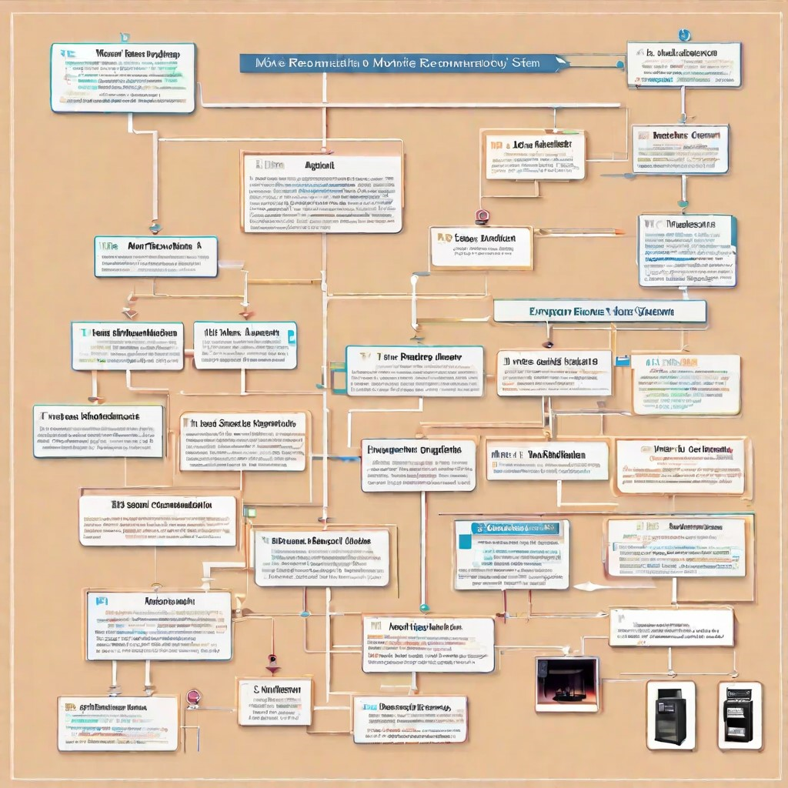
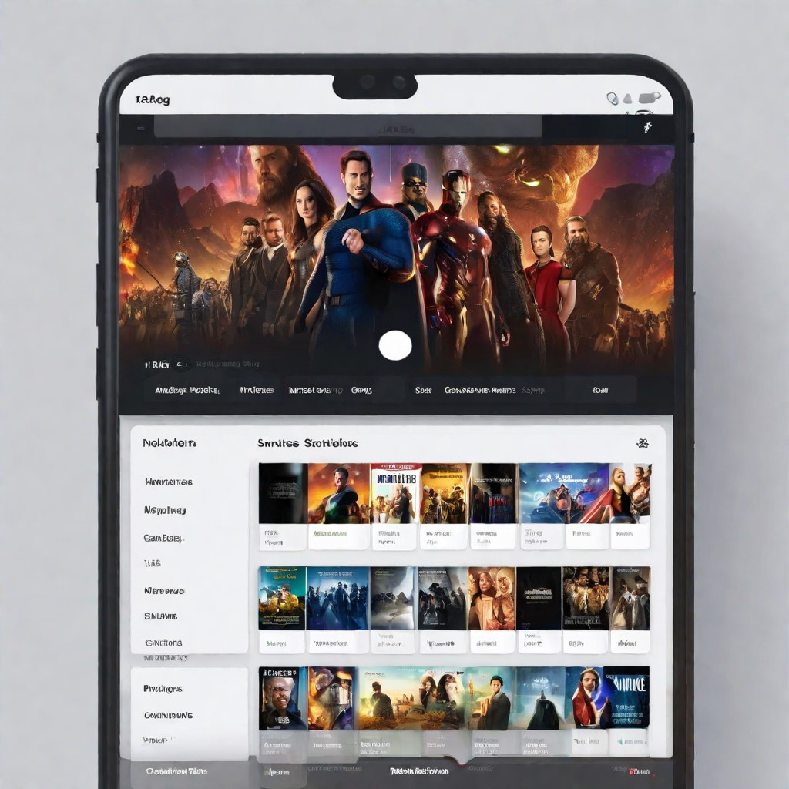
Recommendation System
Machine Learning Algorithm
The recommendation system is powered by a machine learning algorithm that analyzes user data and movie features to suggest personalized movie recommendations.
User Preferences
The app allows users to set their preferences for movie genres, actors, directors, and more, which are then used by the recommendation system to generate personalized recommendations.

Slide 5
Data Analytics
Our movie ratings app is powered by AI modules like pandas, numpy, and TruncatedSVD which enable us to gather and analyze large amounts of data. This data can be used to gain insights into user behavior and preferences, as well as inform marketing strategies.
User Behavior and Preferences:
By analyzing user data, we can identify patterns in movie preferences and behavior. This information can be used to improve our recommendation system and tailor our marketing strategies to specific user segments.
Marketing Strategies:
Data analytics can also inform our marketing strategies. By identifying trends in user behavior and preferences, we can target specific user segments with personalized marketing campaigns. Additionally, we can use data to track the effectiveness of our marketing efforts and make adjustments as necessary.

Slide 6
Marketing Strategy
Partnerships and Collaborations
We will explore partnerships and collaborations with movie studios, streaming services, and other industry players to increase brand awareness and user acquisition. These partnerships can also provide valuable data insights for our data analytics module.
Social Media Campaigns
We will launch targeted social media campaigns to reach our target audience and increase user engagement. These campaigns will focus on the app's unique features and benefits, such as personalized recommendations and easy-to-use interface.
Email Marketing
We will leverage email marketing to communicate with our users and keep them engaged with the app. These emails can include personalized recommendations, new feature announcements, and exclusive promotions.

Slide 7
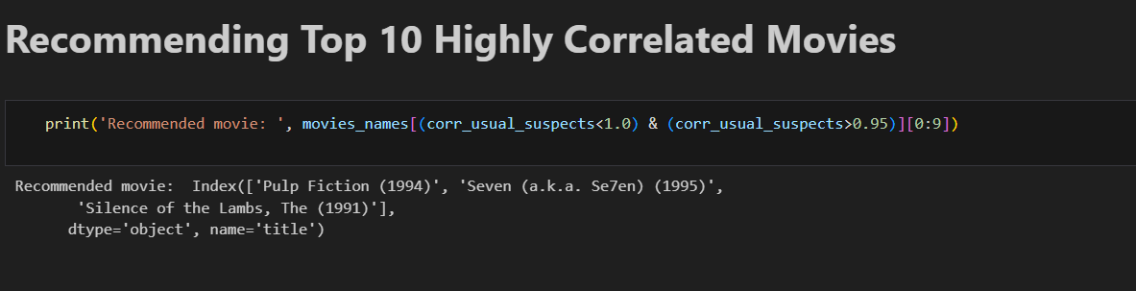
Results

Slide 8
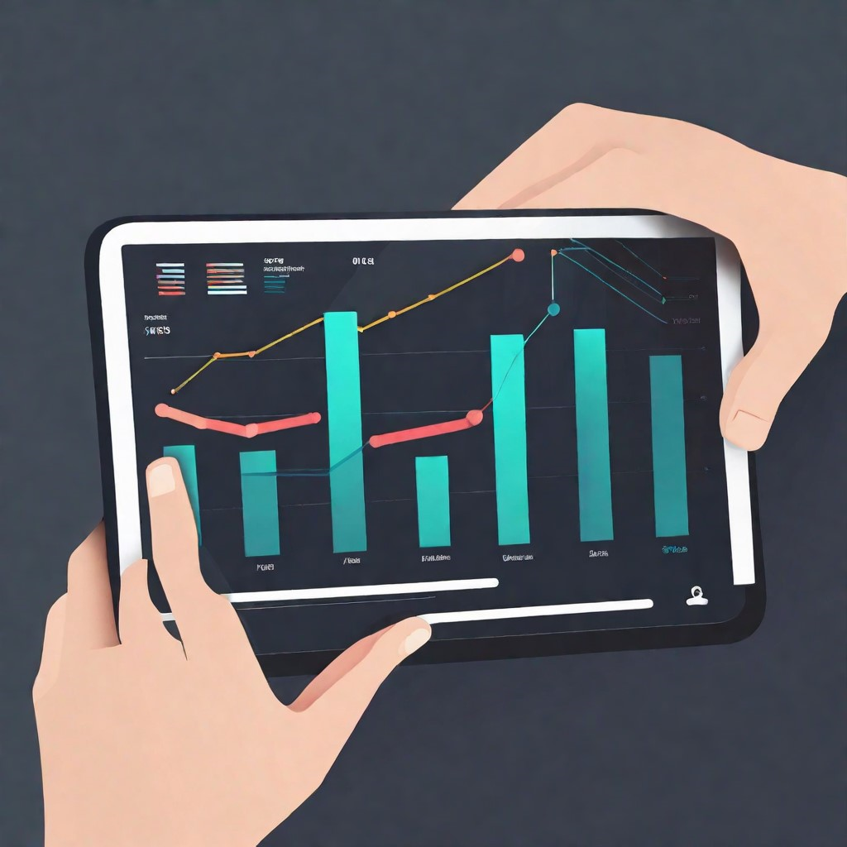

Future Developments
Expansion to TV Shows
In addition to movies, we plan to expand our app to include TV shows. This will require additional AI modules and data analysis, but we believe it will greatly enhance the user experience and increase engagement with the app.
Integration with Social Media Platforms
We are exploring the possibility of integrating our app with popular social media platforms to allow users to share their ratings and reviews with their friends and followers. This would not only increase the app's visibility, but also provide valuable data for our marketing strategies.
Personalized Recommendations
We plan to further improve our recommendation system by incorporating user data such as watch history and genre preferences to provide more personalized recommendations. This will require advanced machine learning algorithms and data analysis, but we believe it will greatly enhance the user experience and increase engagement with the app.

Slide 9
Conclusion
In summary, the movie rating app has revolutionized how we choose and enjoy films. Its user-friendly interface, personalized recommendations, and user-generated reviews have made it an essential tool for movie enthusiasts. Additionally, it has created a vibrant community of film lovers, fostering discussions, and making the cinematic experience more interactive and enjoyable.

Slide 10
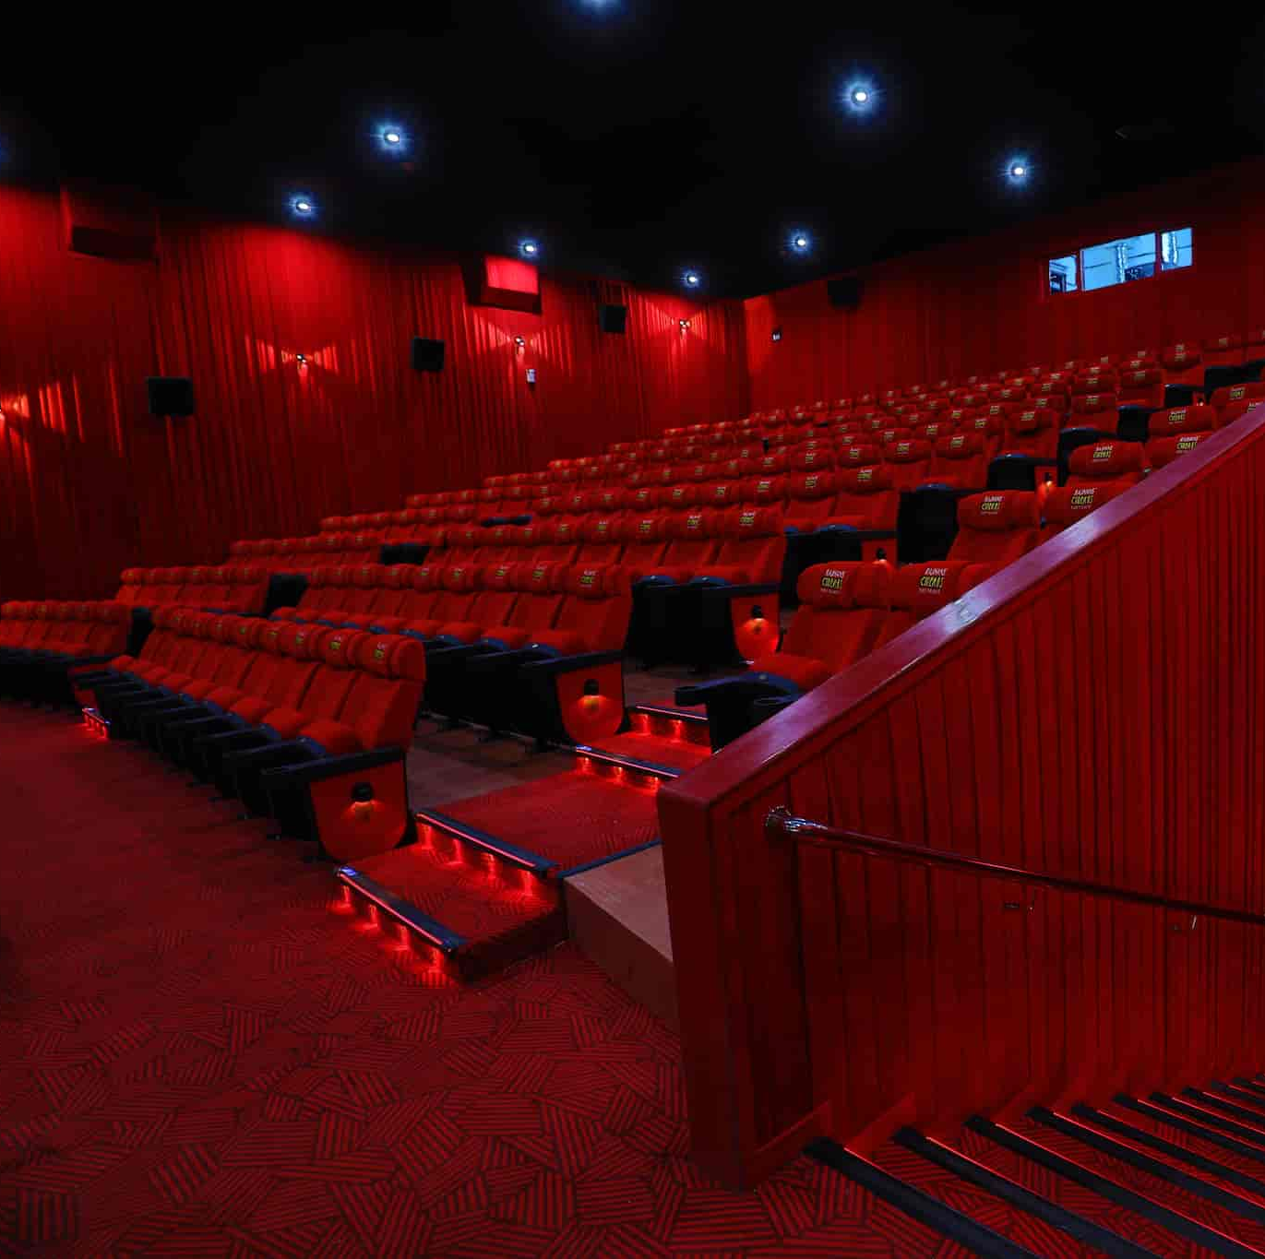
Thank You

